Slide 1
Effects of Sexualization in Advertisements

Slide 2
Statement of the Problem
This research project was designed to see if sexualization of a female model in an advertisement plays a role in memory recall and viewer attitudes about the brand.

Slide 3
Definitions
In this study we are defining sexualization according to the amount of clothes a model is wearing in the advertisement shown. The less clothing the model is wearing, the more she is sexualized in the advertisement (Lombardot, 2007).
Memory recall will be determined by how many objects a participant can remember and list after a brief presentation of an image.
Viewer attitudes will be measured according to a ratings scale from 0 to 100.

Slide 4
Reason for this Study
Advertisements often use sexualized women to sell their products.
We want to know if this sexualization is actually helping to promote the company and sell the product.
We also want to see if memory recall is affected, in order to determine if attention is focused on a sexualized model more than a non-sexualized model.
This will allow us to measure if the model is the focal point of the advertisement, or if viewers are paying attention to other aspects of the image.

Slide 5
Research Background: Walker & Zaid (2011)
This study was designed to demonstrate how sexualization in advertisements can affect the viewer’s opinion of the company and memory recall of the advertisement. The subjects were shown a non-sexualized advertisement, such as a woman holding a product fully clothed, and a sexualized advertisement, such as a woman dressed provocatively holding the product.
The study was relevant to our research because we desired to measure similar dependent variables of memory recall and viewer opinion. Their findings were that in the sexualized condition more details were recalled about the model than the background.

Slide 6
Research Background: Monk-Turner (2008)
This study is relevant to our research because it shows the sexualization of female subjects in advertisements. It also demonstrates that men are often the most influenced by sexualized women in advertisements, and this influence seems to be a positive one.
Monk-Turner looked at advertisements and, if they use sex to sell a product. The results state that sexualized advertisements are usually aimed at male audiences. It also found that women were most often the targets of sexualization.

Slide 7
Research Background: Lombardot (2007)
This is relevant because it shows that someone of the opposite sex will pay more attention to a partially nude model. This attention might draw the viewer to focus on the model more than on the surroundings. This should especially affect men, and having attention focussed on the model might lower their ability to recall other items in the image.
This study focused on nudity in advertisements and how that impacted brand recall and attention getting. This study found that a partially nude image was very effective in getting the attention of someone, particularly for a member of the opposite sex.

Slide 8
Research Background: Nezlek (2014)
This study was designed to see how athletes were rated on their attractiveness and competence when they were presented in a sexualized manner and a non-sexualized manner. The findings were that sexualized athletes were rated as more attractive, but less competent. Women tended to rate sexualized models the lowest in competence.
This is relevant to our study because it gives insights into what is considered attractive, and this may also result in less clothed models being more desirable. It also shows that women may have some negative opinions on the less clothed models, resulting in worse opinions of the brand promoting them.

Slide 9
Hypothesis 1
H1
With clothed models, men and women have about the same memory recall.
Rationale:
Herlitz (1996) conducted a study in which both men and women were tested on their memory recall abilities. The study found that there was no significant difference between men and women when it came to memory.

Slide 10
Hypothesis 2
H2
Men will perform worse than women on the memory recall task when model is not clothed.
Rationale:
According to Lombardot (2007) the opposite sex is most affected by a sexualized image. A female model was used so therefore men should be the most affected by the sexualized model.

Slide 11
Hypothesis 3
H3
Men will perform worse on the memory recall task when the model is not clothed than when she is clothed.
Rationale:
Monk-Turner (2008) found that male audiences are often the target audience for sexualized advertisements because they are the most affected by them.

Slide 12
Hypothesis 4
H4
Women will perform the same on the memory recall task regardless of if the model is clothed or not.
Rationale:
Lombardot (2007) found that showing nudity is effective if gaining attention of the opposite sex, but does not have a significant effect for the same sex.

Slide 13
Hypothesis 5
H5
Men will have higher opinions and want to buy the product more than women when model is sexualized.
Rationale:
Nezlek (2014) showed that women had worse opinions of brands that showed a sexualized woman. Monk-Turner (2008) found that men seemed to have a positive reaction to a sexualized image of a woman.

Slide 14
Experimental Design
Sexualization
Independent Variables
Amounts of Clothing on model
Gender of Viewer
Dependent Variables
Items Recalled
General Attitudes About Company
Purchase probability
 | Less Clothes | More clothes
Males | N = 10 | N = 10
Females | N = 10 | N = 10
Gender of Viewer

Slide 15
Methods
Questionnaire was composed through qualtrics in order to collect data.
Demographics
Age
Gender
Instructions with image display
Variable questions
Participants:
40 subjects
20 males
20 females
Mean: 21.8

Slide 16
Method: Materials
Questionnaire asking demographic questions, ratings of company, probability of buying, and how many items in image they recalled.
Two advertisements for Carl’s Jr. One with a model who is fully clothed and one with a model in a bathing suit.

Slide 17
Advertisement 1
Advertisement 2

Slide 18
Method: Procedure
Step 1: Participants were randomly assigned to see either a clothed model or a model in a bathing suit.
Step 2: Participants were asked demographic questions such as age, gender, and education level.
Step 3: Participants were prompted before seeing image to study it well enough to be able to describe it to a friend.
Step 4: The image was then displayed for 6 seconds.
Step 5: Participants were asked to give ratings of company opinion and probability of buying the product, as well as, a list of the items they recalled.

Slide 19
Method: Data Source
Data was entered into SPSS to determine gender differences in memory recall for non-sexualized and sexualized model and significant gender differences between attitude and probability of purchase.
Results were interpreted using a two-sample t-test.

Slide 20
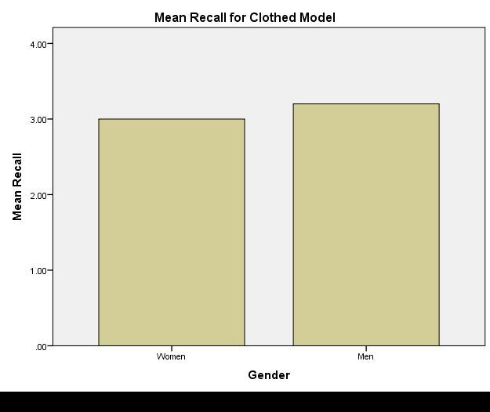
Results: Gender Differences in Clothed Model
Hypothesis 1: With clothed models men and women have about the same memory recall.
Confirmed. There was no significant difference between men and women’s memory recall for the clothed model.
Mean for Woman: 3
Mean for Man: 3.2
t(18)= -.264, N.S.

Slide 21
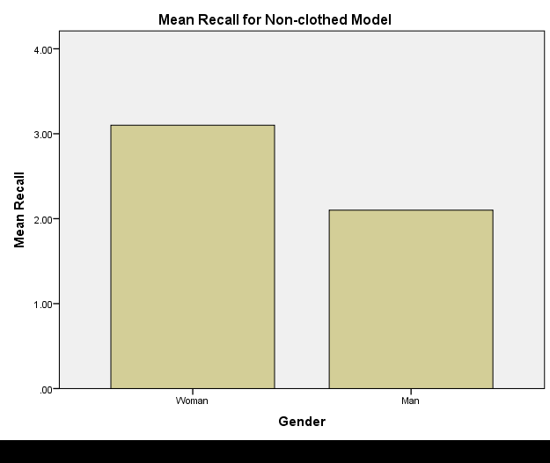
Results: Gender Differences for Non-Clothed Model
Hypothesis 2: Men will perform worse than women on the memory recall task when model is not clothed.
Confirmed. With the non-clothed model men performed significantly worse than women.
Mean for Woman: 3.1
Mean for Man: 2.1
t(18)=2.76, p<.05

Slide 22
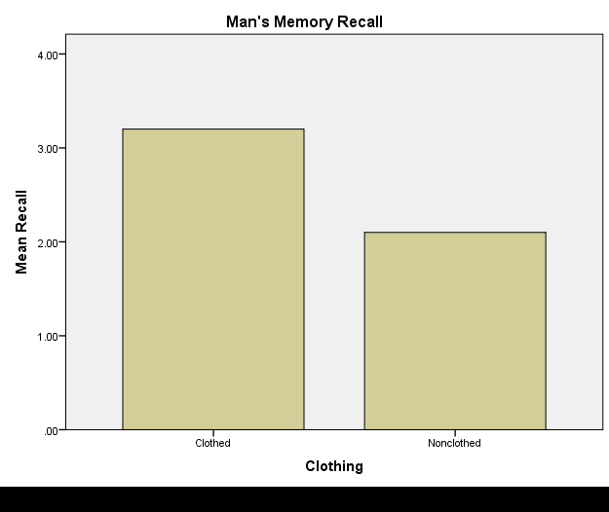
Results: Clothing Differences in Men
Hypothesis 3: Men will perform worse when the model is not clothed than when she is clothed.
Confirmed. There was a significant difference, men performed worse when shown the non-clothed model compared to the clothed model.
Clothed Mean: 3.2
Non-clothed Mean: 2.1
t(18)= 1.640, p < .05

Slide 23
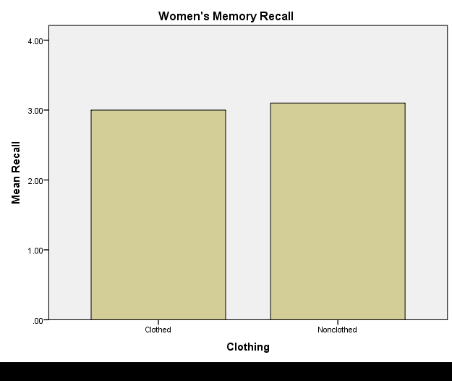
Results: Clothing Differences in Women
Hypothesis 4: Women perform the same regardless of if the model is clothed or not.
Confirmed. There was no significant difference between women’s memory recall regardless of if the model was clothed or not.
Clothed Mean: 3.0
Non-clothed Mean: 3.1
t(18)=-.198, N.S.

Slide 24
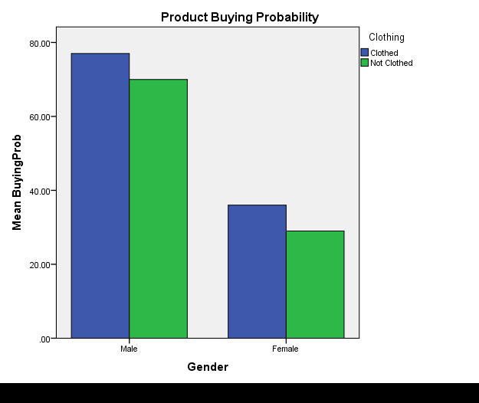
Results: Probability of Buying
Hypothesis 5: Men will have higher opinions and want to buy the product more than women when model is sexualized.
Confirmed. There was a significant difference between men and women’s opinions about the company and purchase probability. However, this occurred regardless of if the model was clothed or not.
Men: Clothed Mean: 77, Non-clothed Mean: 70
Women: Clothed Mean: 36, Non-clothed Mean: 29
t(18)=-6.290, p<.05

Slide 25
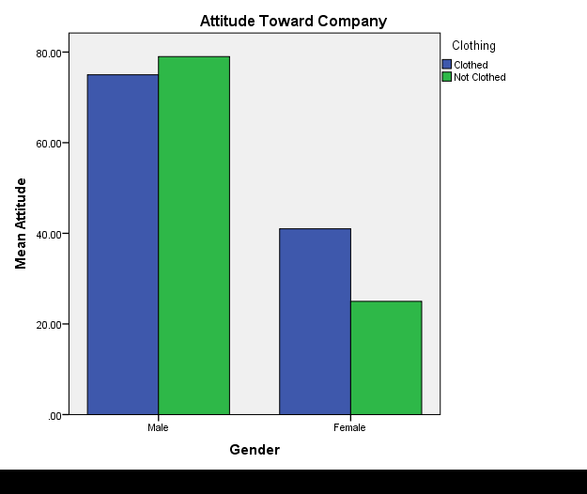
Results: Attitude Toward Company
Hypothesis 5 (also): Men will have higher opinions and want to buy the product more than women when model is sexualized.
Confirmed. There was a significant difference between men and women’s opinions about the company and purchase probability. However, this occurred regardless of if the model was clothed or not.
Men: Clothed Mean: 75, Non-clothed Mean: 79
Women: Clothed Mean: 41 Non-Clothed Mean: 25
t(18)= -8.111, p<.05

Slide 26
Summary of Results
The only significant difference between memory recall was a gender difference with the non-clothed model. Men were significantly worse at memory recall when the model was not wearing clothes compared to women.
There was also a significant gender difference between males and females regarding attitude about company and probability of buying. Women rated the company much less favorably than men, and wanted to buy the product much less.
The last significant result presented was that within male subjects. Those who were shown the sexualized non-clothed model, performed significantly worse than their male peers that were shown with the clothed model.

Slide 27
Interpretation
According to our results, men and women do have the same amount of memory recall when the model is clothed. However, when the model is sexualized men are worse at the memory recall task than women. Men in general performed more poorly when shown the sexualized advertisement versus the non-sexualized model. This suggests that men are more drawn to looking at the model, and do not focus as much on the background when the model is in a bathing suit. All other conditions did not produce significant results.

Slide 28
Discussion
Limitations:
-Consumers may have rated the company and probability of purchase based off of prior knowledge of company and not based off of the advertisement.
- Model may have been sexualized enough in both conditions to alter some results.
Recommendations:
-This study could be done with more drastic differences between sexualized and non-sexualized conditions
-Multiple brands could be used in order to ensure that the company alone was not the reason for the ratings.

Slide 29
References
Herlitz, A., Nilsson, LG. & Bäckman, L. Memory & Cognition (1997) 25: 801. https://doi.org/10.3758/BF03211324
Lombardot, É. (2007). Nudity in Advertising: What Influence on Attention-Getting and Brand Recall? Recherche Et Applications En Marketing (English Edition), 22(4), 23-41. doi:10.1177/205157070702200401
Nezlek, J. B., Krohn, W., Wilson, D., & Maruskin, L. (2014). Gender Differences in Reactions to the Sexualization of Athletes. The Journal of Social Psychology, 155(1), 1-11. doi:10.1080/00224545.2014.959883
Monk-Turner, E., Wren, K., Mcgill, L., Matthiae, C., Brown, S., & Brooks, D. (2008). Who is gazing at whom? A look at how sex is used in magazine advertisements. Journal of Gender Studies, 17(3), 201-209. doi:10.1080/09589230802204167
Walker, P., & Zaid, A. (2011). The effects of sexualization in advertisements. Hanover College.

